Slide 1
Regression Models
Tomas Karpati tc.datascience@gmail.com
054-2002430

Slide 2
Regression Metrics

Slide 3
Regression Metrics
Regression Metrics
Mean Squared Error (MSE)
Root Mean Squared Error (RMSE)
Mean Absolute Error (MAE)
R Squared (R²) / Adjusted R Squared (R²)
Root Mean Squared Logarithmic Error (RMSLE)
Information Criteria (AIC, BIC)

Slide 4
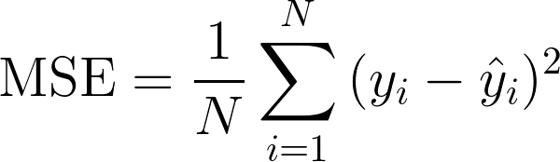
Regression Metrics
Mean Squared Error (MSE)
The most simple and common metric in use
Useful if we have unexpected values (very high or low) that we should care about.
Not good in presence of noise
May overestimate in both directions: may mistakenly show that a model is worst or better than it really is

Slide 5

Regression Metrics
Root Mean Squared Error (RMSE)
RMSE is just the square root of MSE
It behaves like MSE and has the same problems as well
The only advantage over MSE is that it make the scale of the errors to be the same as the scale of targets
Most people prefer to use MSE because it’s simpler

Slide 6
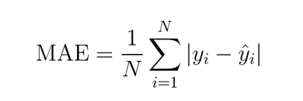
Regression Metrics
Mean Absolute Error (MAE)
Is a linear score which means that all the individual differences are weighted equally in the average.
A difference of 10 between y_hat and y is twice a difference of 5.
This metric penalizes huge errors.
Less sensitive to outliers
Less commonly used than MSE and RSME

Slide 7
Regression Metrics
Root Mean Squared Logarithmic Error (RMSLE)
RMSLE penalizes an under-predicted estimate greater than an over-predicted estimate
This metric penalizes huge errors.
Less sensitive to outliers
Less commonly used than MSE and RSME
RMSLE = √ ∑(log(Y + 1) - log(Y + 1))²

Slide 8
Regression Metrics
MSE_{model} 1/n ∑(Y_{i} - Y_{i})²
R² = 1 - = 1 -
MSE_{baseline} 1/n ∑(Y_{i} - Y_{i})²
⌃
R Squared (R²)
The coefficient of determination (R²) is a metric that show us how much our model reduced the variability when compared to the simple mean of the outcome (constant baseline).
Closely related to MSE, but has the advantage of being scale-free .
It takes values between -∞ and 1. A negative value indicates that our model is worst than predicting the mean.
⎺

Slide 9

Regression Metrics
Adjusted R Squared (adj-R²)
This metric is more robust than the R²
Is less affected by changes on the number of features

Slide 10
Regression Metrics
Which metric is the best for my regression problem?
Need a measure for how good the model performs ⇨ R²
Only need to compare between models:
Outliers are absent ⇨ MSE / RMSE
Outliers are present ⇨ MAE
Large difference between values of Y ⇨ RMSLE

